Slide 1
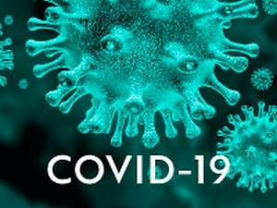

It is time to consider an anti-inflammatory therapy
based on the pathophysiology of COVID-19 infection
during the right time window?
DOI: 10.5114/aoms/130647
Arch Med Sci 2021;17(2):546-550

