Slide 1
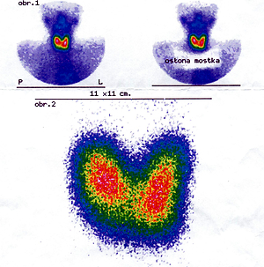

Follicular adenoma of the thyroid gland in children: a clinical spectrum
DOI: 10.5114/aoms/130994
Arch Med Sci 2025;21(3):802-807
Notes:
Introduction
Surgical diseases of the thyroid gland in children are rare in
comparison with those in the adult population. The aim of the study was to
assess clinical aspects of thyroid follicular adenoma in children and attempt
to develop a management algorithm that is useful in clinical practice.
Material and methods
The clinical database of all children operated on due
to thyroid disease in the years 1993–2018 at the university pediatric surgical center was reviewed. The children in whom the postoperative histology
report showed follicular adenoma were selected and their medical files were
analyzed in detail. Clinical course of the disease, medical and family history,
results of imaging studies, details of surgical management and final outcome were assessed in each case.
Results
Among 183 children operated on for thyroid pathology in the study
period there were 56 patients with follicular adenoma (30.6%). Their age
ranged from 7 to 18 years. Seven patients were found to be hypothyroid
and a further seven showed hyperthyroid status initially. Ultrasound scan
showed a solitary nodule in 37 children (66.1%). Multiple nodules in one
lobe were detected in 5 patients, while a further 14 children showed bilateral thyroid pathology. The result of preoperative cytologic examination was
suspicious in 12 children (21.4%). All children were subjected to operative
management. Forty-two children (75%) underwent at least unilateral total
lobectomy. No patient showed a recurrent thyroid disease.
Conclusions
Follicular adenoma in children presents a wide clinical and
morphological spectrum. High incidence of associated diseases of other systems and congenital anomalies of the thyroid gland may indicate a complex
etiology of follicular adenoma with participation of still unknown endogenic
factors in children.

