Slide 1
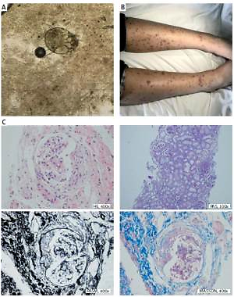

Scabies, incomplete lupus erythematosus and Henoch-Schonlein purpura
DOI: 10.5114/aoms/131542
Arch Med Sci 2021;17(2):564-568

