Slide 1
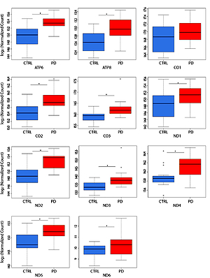

mRNA expression profiling of mitochondrial subunits in subjects with Parkinson’s disease
DOI: 10.5114/aoms/131629
Arch Med Sci 2023;19(3):678-686
Notes:
Introduction
Parkinson’s disease (PD) is a common adult-onset neurodegenerative disorder caused by a progressive loss of dopaminergic neurons due to the accumulation of α-synuclein in the substantia nigra. Mitochondria are known to play a key role in cell respiratory function and bioenergetics. Indeed, mitochondrial dysfunction causes insufficient energy production required to satisfy the needs of several organs, especially the nervous system. However, the profiling of messenger RNA (mRNA) expression of mitochondrial subunits in PD has not been systematically investigated yet.
Material and methods
We explored the mRNA expression of mitochondrial DNA (mtDNA) encoded respiratory chain (RC) subunits in 43 PD patients and 43 normal controls (NC). Next generation sequencing analysis (NGS) was used and quantitative real-time polymerase chain reaction (qRT-PCR) assay was used for confirmation of the NGS results.
Results
All tested mitochondrial RC subunits were significantly over-expressed in subjects with PD compared to NC. In qRT-PCR the mean expression of all mitochondrial subunits had an expression level of at least 7 times compared to NC.
Conclusions
The over-expression of mitochondrial subunits in PD subjects with respect to NC might be secondary to a degeneration-related alteration of the mitochondrial structure and/or dynamics, or to the occurrence of a compensatory mechanism. The study of specific mRNA by peripheral blood mononuclear cells may provide a further diagnostic frame for early detection PD patients.

