Slide 1
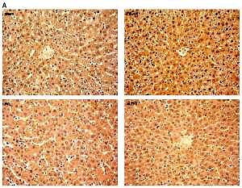

Injection of CD86+ macrophages instead of liver partition accelerates liver regeneration after portal vein ligation in rats
DOI: 10.5114/aoms/133361
Arch Med Sci 2021;17(3):843-847

