Slide 1
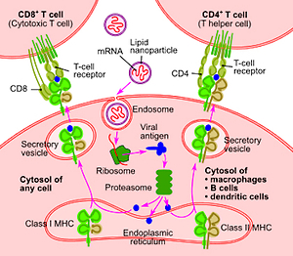

Could amantadine possibly interfere with COVID-19 vaccines based on LNP-mRNA platform ?
DOI: 10.5114/aoms/134716
Arch Med Sci 2021;17(3):827-828
Notes:
Introduction
Amantadine is a well-known medication with indications in neurology and infectious diseases. It is currently FDA approved for Parkinson disease, drug induced extrapyramidal symptoms, and influenza.
Material and methods
The article is author's original research hypothesis.
Results
Because more people are going to be vaccinated and additional
similar vaccines are going to be introduced, we should take into consider_x0002_ation the potential of amantadine to interfere with LNP-mRNA COVID-19
vaccine delivery into the target cells.
Conclusions
A more cautious approach to the patients taking amantadine as far as vaccination utilizing LNP-mRNA platform should be considered.

