Slide 1
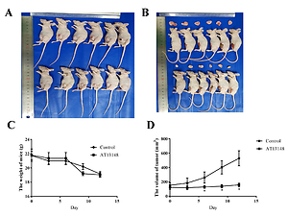

Study on the potential effect of multi-AGC kinase AT13148 on the Notch signaling pathway in glioblastoma
DOI: 10.5114/aoms/135083
Notes:
Introduction
Glioblastoma is the most malignant astrocytoma, and the efficacy of its therapy is not ideal. The Notch signaling pathway plays an important role in tumor proliferation and invasion. Whether the small molecule drug AT13148 can affect glioblastoma by regulating the Notch signaling pathway is the focus of this study.
Material and methods
In vitro, the glioblastoma U87 cell line transfected with sh-ITGB1 (U87<sup>sh-ITGB1</sup>), the U87 cell line transfected with oe-ITGB1 (U87<sup>oe-ITGB1</sup>) and the control group were treated with the small molecular drug AT13148. RT-qPCR, western blot and clone formation ability assays were used to detect the mRNA and protein expression of the ITGB1 and the key gene NOTCH1, as well as the proliferation of cancer cells. Therapeutic effects of AT13148 were examined in vivo using a nude mouse model of U87 cells. After treatment with AT13148, volume of tumors was calculated, and RT-qPCR and western blot were used to evaluate the mRNA and protein expression of ITGB1 and NOTCH1.
Results
AT13148 inhibits the activity of U87 cells. Lentiviral transfection of sh-ITGB1 and oe-ITGB1 can interfere with the expression of ITGB1 in U87 cells. AT13148 could down-regulate both the expression of ITGB1 and NOTCH1. Moreover, AT13148 affects the cloning ability of U87 cells. AT13148 can also inhibit the proliferation of U87 cells. Furthermore, AT13148 inhibited the proliferation and invasion of transplanted tumors in vivo.
Conclusions
This study indicated that AT13148 could affect the expression of ITGB1 and NOTCH1, which also could be a potential anti-glioblastoma small molecule drug candidate in clinical medicine.

