Slide 1
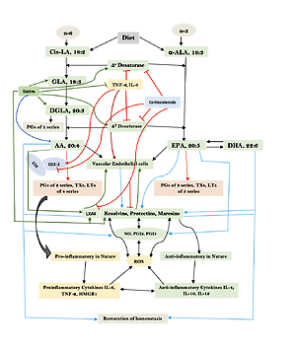

Bioactive lipid-based therapeutic approach to COVID-19 and other similar infections
DOI: 10.5114/aoms/135703
Arch Med Sci 2023;19(5):1327-1359
Notes:
COVID-19 is caused by SARS-CoV-2 infection. Epithelial and T, NK, and other immunocytes release bioactive lipids especially arachidonic acid (AA) in response to microbial infections to inactivate them and upregulate the immune system. COVID-19 (coronavirus) and other enveloped viruses including severe acute respiratory syndrome (SARS-CoV-1 of 2002-2003) and Middle East respiratory syndrome (MERS; 2012-ongoing) and hepatitis B and C (HBV and HCV) can be inactivated by AA, g-linolenic acid (GLA, dihomo-GLA (DGLA), eicosapentaenoic acid (EPA), docosahexaenoic acid (DHA), which are precursors to several eicosanoids. Prostaglandin E1, lipoxin A4, resolvins, protectins and maresins enhance phagocytosis of macrophages and leukocytes to clear debris from the site(s) of infection and injury, enhance microbial clearance and wound healing to restore homeostasis. Bioactive lipids modulate the generation of M1 and M2 macrophages and the activity of other immunocytes. Mesenchymal and adipose tissue-derived stem cells secrete LXA4 and other bioactive lipids to bring about their beneficial actions in COVID-19. Bioactive lipids regulate vasomotor tone, inflammation, thrombosis, immune response, inactivate enveloped viruses, regulate T cell proliferation and secretion of cytokines, stem cell survival, proliferation and differentiation, and leukocyte and macrophage functions, JAK kinase activity and neutrophil extracellular traps and thus, have a critical role in COVID-19.

