Slide 1
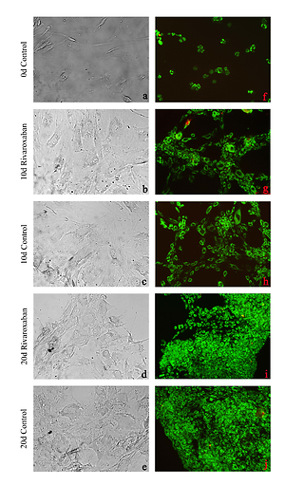

The effects of rivaroxaban, an oral anticoagulant, on human IVD primary cultures
DOI: 10.5114/aoms/136323
Arch Med Sci 2022;18(4):1062-1070
Notes:
Introduction
The present study aimed to investigate the potential effects
of rivaroxaban, an oral anticoagulant that inhibits the effects of factor Xa,
on intact intervertebral disc tissue cells and the extracellular matrix (ECM).
Material and methods
Rivaroxaban was applied to primary human cell cultures prepared from tissues of the intervertebral disc. Comparative molecular analyses were performed on non-drug-treated control group samples.
Descriptive statistics were presented as the mean ± standard deviation. An
analysis of variance test was performed to determine whether there were significant differences in the mean across the groups. When differences across
groups were observed, Tukey’s honestly significant difference post-hoc test
was used for multiple pairwise comparisons. The significance of the obtained
data was determined statistically. The α significance value was < 0.05.
Results
The cells in the control group and in the rivaroxaban-treated group
were viable, healthy, and proliferated (p < 0.05). However, the expression
levels of the chondroadherin gene (CHAD), cartilage oligo matrix protein
(COMP), matrix metalloproteinase (MMP)-13, and MMP-19 genes were
changed (p < 0.05).
Conclusions
Although rivaroxaban does not suppress cell proliferation due
to morphological, biological, and biochemical changes in the intervertebral
disc tissue, it may change the expression of genes that are related to ECM
maintenance.

