Slide 1
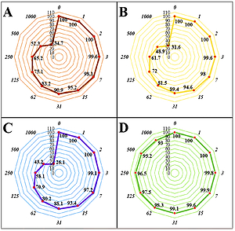

Antioxidant, cytotoxicity, and anti-human lung cancer properties of Linum usitatissimum seed aqueous extract in in vitro conditions: a pre-clinical trial study
DOI: 10.5114/aoms/136340
Notes:
Introduction
Linum usitatissimum seed or flax seed is known as a potential candidate as a remedy to treat various diseases in many traditional medicines around the world. In the current study, the antioxidant, cytotoxicity, and anti-human lung cancer properties of Linum usitatissimum seed were investigated in in vitro conditions.
Material and methods
Antioxidant activity of the plant was analyzed using radical scavenging activity and ferrous ion chelating assay. 3-(4,5-dimethylthiazol-2-yl)-2,5-diphenyl-2H-tetrazolium bromide (MTT) assay was used to evaluate anti-lung cancer properties of the plant.
Results
The plant extract scavenged 2,2-diphenyl-1-picrylhydrazyl (DPPH) as a free radical with an IC50 of 34.2 ±0.9 µg/ml. The plant was also found to be rich in phenolic compounds with 294.8 ±2.3 mg GAE/g for total phenolic content. Cell viability of Linum usitatissimum seed was very low against lung poorly differentiated adenocarcinoma (PC-14), lung moderately differentiated adenocarcinoma (LC-2/ad), and lung well-differentiated bronchogenic adenocarcinoma (HLC-1) cell lines without any cytotoxicity towards the normal cell line. The best anti-human lung cancer properties of Linum usitatissimum seed against the above cell lines were observed in the case of the PC-14 cell line. According to the above findings, Linum usitatissimum seed may be administered for the treatment of several types of human lung cancer in humans. According to the results, the IC50 values of plant extract against lung poorly differentiated adenocarcinoma (PC-14), lung moderately differentiated adenocarcinoma (LC-2/ad), and lung well-differentiated bronchogenic adenocarcinoma (HLC-1) cell lines were found to be 392, 483, and 564 µg/ml, respectively.
Conclusions
It appears the recent formulation can be used as a novel chemotherapeutic supplement in humans.

