Slide 1
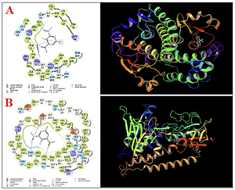

Anti-human lung cancer activities and survey
of glutathione reductase and glutathione S transferase
inhibition properties with molecular modeling studies
of 2′-hydroxy-5′-methyl-3′-nitroacetophenone:
a pre-clinical trial study
DOI: 10.5114/aoms/136341
Notes:
Introduction
The molecular docking method was found to calculate the biological activity of the 2′-hydroxy-5′-methyl-3′-nitroacetophenone (2′-H-5′-
M-3′-N) molecule against the enzymes studied.
Material and methods
In these calculations, the enzymes used were glutathione reductase (GR) and glutathione S-transferase (GT). After the modeling calculations were completed, the ADME/T parameters were examined
to calculate the future drug use properties of the 2′-H-5′-M-3′-N molecule.
To survey the antioxidant properties of 2′-H-5′-M-3′-N, the DPPH test was
used. Several human lung adenocarcinoma cell lines, i.e., lung moderately
differentiated adenocarcinoma (LC-2/ad), lung poorly differentiated adenocarcinoma (PC-14), and lung well-differentiated bronchogenic adenocarcinoma (HLC-1) cell lines, were used to determine the anticancer properties
of the molecule.
Results
Cell viability of 2′-H-5′-M-3′-N was very low against PC-14, LC-2/ad,
and HLC-1 cell lines without any cytotoxicity towards the normal cell line.
The IC50 values of 2′-H-5′-M-3′-N against LC-2/ad, PC-14, and HLC-1 cell lines
were 475, 250, and 691 µg/ml, respectively. The best anti-human lung cancer properties of 2′-H-5′-M-3′-N against the above cell lines were observed
in the case of the PC-14 cell line.
Conclusions
2′-H-5′-M-3′-N was found to have significant antioxidant and
anti-human lung cancer properties. It appears that the anti-human lung carcinoma effect of 2′-H-5′-M-3′-N is due to its antioxidant effects.

