Slide 1
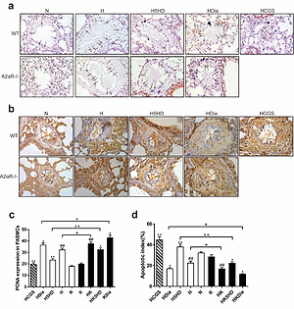

Adenosine A2a Receptors Improve Hypoxic Pulmonary Arterial Hypertension Via Mitochondrial ATP-sensitive Potassium Channels
DOI: 10.5114/aoms/136345
Notes:
Introduction
This study is aimed to explore the effects of Adenosine A2a receptors (A2aR) on hypoxia-induced pulmonary hypertension (HPH) via mitochondrial ATP-sensitive potassium channels (MitoKATP) in vivo and in vitro.
Material and methods
Using wild-type (WT) and A2aR-deficient (A2aR-/-) mice; hypoxic pulmonary artery smooth muscle cells (PASMCs) were induced by a 24-hours hypoxia exposure. Mice and PASMCs were treated with the A2aR agonist CGS21680, MitoKATP blocker 5-hydroxydecanoic acid sodium salt (5HD), or MitoKATP agonist diazoxide. Mitochondrial morphology was observed by electron microscopy. The mitochondrial membrane potential (Δψm); invasive hemodynamic parameters; right ventricular (RV) hypertrophy index; pulmonary arterial remodeling index; proliferative and apoptotic indexes; protein expression levels of A2aR, Bax, Bcl-2, and Caspase-9; and release of cytochrome C from the mitochondria to the cytoplasm were measured.
Results
In vitro, hypoxia induced the opening of MitoKATP. The up-regulation of A2aR reduced the opening of MitoKATP, and the blocking of MitoKATP or activating A2aR promoted mitochondria-dependent apoptosis of PASMCs. In vivo, compared with WT mice, A2aR-/- mice displayed increased RV systolic pressure, RV hypertrophy index, and pulmonary arterial remodeling index. The expression levels of Bax, cytochrome C, and Caspase-9 were higher and Bcl-2 expression was lower in A2aR-/- mice than in WT mice. CGS21680 could reverse hypoxia-induced hemodynamic changes, RV hypertrophy, and pulmonary arterial remodeling as well as abnormal proliferation and apoptosis resistance in WT mice with pulmonary hypertension (PH).
Conclusions
A2aR induced the mitochondrial-dependent apoptosis pathway and inhibited PASMC proliferation by blocking MitoKATP, thereby inhibiting pulmonary vascular structural remodeling and reducing PH.

