Slide 1
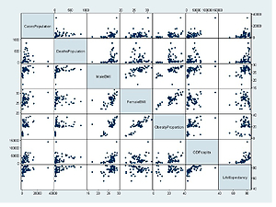

Is COVID-19 another case of the obesity paradox? Results from an international ecological study on behalf of the REPROGRAM Consortium Obesity study group
DOI: 10.5114/aoms/136447
Arch Med Sci 2023;19(1):25-34
Notes:
Introduction
Obesity has emerged as one of the major risk factors of severe morbidity and cause-specific mortality among severe acute respiratory syndrome coronavirus-2 (SARS-CoV-2) infected individuals. Patients with obesity also have overlapping cardiovascular diseases and diabetes, which make them increasingly vulnerable. This novel ecological study examines the impact of obesity and/or body mass index (BMI) on rates of population-adjusted cases and deaths due to coronavirus disease 2019 (COVID-19).
Material and methods
Publicly available datasets were used to obtain relevant data on COVID-19, obesity and ecological variables. Group-wise comparisons and multivariate logistic regression analyses were performed. The receiver operating characteristic curve (ROC) was plotted to compute the area under the curve.
Results
We found that male BMI is an independent predictor of cause-specific (COVID-19) mortality, and not of the caseload per million population. Countries with obesity rates of 20–30% had a significantly higher (approximately double) number of deaths per million population to both those in < 20% and > 30% slabs. We postulate that there may be a U-shaped paradoxical relationship between obesity and COVID-19 with the cause-specific mortality burden more pronounced in the countries with 20–30% obesity rates. These findings are novel along with the methodological approach of doing ecological analyses on country-wide data from publicly available sources.
Conclusions
We anticipate, in light of our findings, that appropriate targeted public health approaches or campaigns could be developed to minimize the risk and cause-specific morbidity burden due to COVID-19 in countries with nationwide obesity rates of 20–30%.

