Slide 1
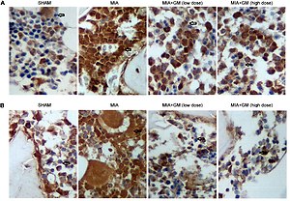

Gentiana macrophylla exhibits a potential therapeutic effect on osteoarthritis (OA) via modulating disease-related proteins
DOI: 10.5114/aoms/136487
Notes:
Introduction
Prostaglandin E2 (PGE2) has been reported to cause cartilage degradation in the pathogenesis of osteoarthritis (OA). Matrix metallopeptidases (MMPs) play important roles in the pathogenesis of OA, while p-AKT and p-P39 signaling pathways were reported to be activated in the pathogenesis of OA. In this study, we aimed to investigate the effect of Gentiana macrophylla (GM) on the treatment of OA.
Material and methods
Primary rat chondrocytes were treated with PBS, IL-1β, and IL-1β+GM respectively to established in vitro models, and in vivo models were set up as a SHAM group, a monoiodoacetic acid (MIA) group, a MIA+GM (low dose) group and a MIA+GM (high dose) group.
Results
In primary rat chondrocytes, the IL-1β treatment elevated the expression of PGE2 and COX2 mRNA. However, the GM treatment reduced the expression of PGE2 mRNA and COX2 mRNA. Also, the GM treatment reduced the expression of above MMPs in primary rat chondrocytes treated with IL-1β. Moreover, unlike P38 and AKT, GM treatment could reduce the expression of p-P38 and p-AKT in primary rat chondrocytes treated with IL-1β. Also, GM treatment reduced the up-regulated expression of COX2, MMPs including MMP-1, MMP-3 and MMP-13, and p-P38 and p-AKT in OA rat models, thus exhibiting a therapeutic effect on OA pathology.
Conclusions
Our study demonstrated the inhibitory effect of GM on the up-regulated expression of PGE2, Cyclooxygenase-2 (COX-2), MMPs including MMP-1, MMP-3 and MMP-13, AKT and P38 in OA models, thus verifying the therapeutic effect of GM on the treatment of OA.

