Slide 1
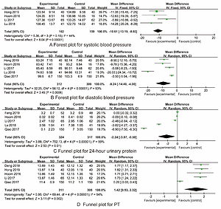

Efficacy and safety of low-dose aspirin combined with low-molecular-weight heparin in treatment of preeclampsia: a meta-analysis and systematic review
DOI: 10.5114/aoms/136518
Arch Med Sci 2022;18(6):1525-1534
Notes:
Introduction
The role of low-dose aspirin combined with low-molecular-weight heparin (LMWH) in the treatment of preeclampsia (PE) remains unclear. We aimed to assess the efficacy and safety of low-dose aspirin combined with LMWH in PE treatment, to provide evidence for clinical PE management.
Material and methods
We searched PubMed and other databases for randomized controlled trials (RCTs) on the effects and safety of low-dose aspirin and LMWH in the treatment of PE up to January 31, 2021. Two researchers strictly followed the inclusion and exclusion criteria to independently conduct the literature screening, data extraction and quality evaluation. We used RevMan 5.3 statistical software for synthesized analysis.
Results
A total of 8 RCTs involving 861 patients were included. The synthesized outcome indicated that the differences in systolic blood pressure (MD = –10.61, 95% CI: –13.19 – –8.02), diastolic blood pressure (MD = –9.24, 95% CI: –14.49– –4.00), 24-hour urinary protein (MD = –2.24, 95% CI: –3.97– –0.50), prothrombin time (MD = 1.42, 95% CI: 0.53–2.32), activated partial thromboplastin time (MD = 2.91, 95% CI: 2.06–3.75), FIB (MD = –1.24, 95% CI: –1.32– –1.15), and adverse perinatal outcomes (MD = 0.41, 95% CI: 0.20–0.85) between the two groups were statistically significant (all p < 0.05), while the difference in the adverse reactions of pregnant women (MD = 0.44, 95% CI: 0.18–1.10) between the two groups was not statistically significant (p = 0.08). No publication bias was detected in all the synthesized outcomes (all p > 0.05).
Conclusions
Low-dose aspirin combined with LMWH treatment of PE may be advantageous to improve blood pressure, 24-hour proteinuria and coagulation function, and it may reduce the adverse reactions in pregnant women without increasing adverse perinatal outcomes.

