Slide 1
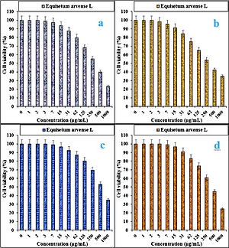

<i>Equisetum arvense</i> L aqueous extract: a novel chemotherapeutic supplement for treatment of human colon carcinoma
DOI: 10.5114/aoms/138146
Arch Med Sci 2023;19(5):1472-1478
Notes:
Introduction
One of the plants that has long been considered by humans is Equisetum arvense L. Equisetum arvense L is now recommended for external use to heal wounds and for internal use to relieve urinary tract and prostate disorders. In the current study, the antioxidant, cytotoxicity, and anti-human lung cancer properties of Equisetum arvense were investigated in in vitro conditions.
Material and methods
Total phenolic content, total flavonoid content, radical scavenging activity, and ferrous ion chelating were assessed to evaluate the antioxidant activity. 3-(4,5-dimethylthiazol-2-yl)-2,5-diphenyl-2H-tetrazolium bromide (MTT) assay was chosen to investigate anticancer activity of the plant extract.
Results
The plant extract scavenged 2,2-diphenyl-1-picrylhydrazyl (DPPH) as a free radical with an IC50 of 12.3 ±0.7 µg/ml better than positive controls. The plant was also rich in phenolic compounds with an amount of 396.2 ±3.2 mg GAE/g for total phenolic content. In the MTT assay, human colorectal carcinoma (HCT-8 [HRT-18], Ramos.2G6.4C10, HT-29, and HCT 116) and normal cell lines (HUVEC) were used to study the cytotoxicity and anticancer potential of Equisetum arvense L against human colorectal cancer.
Conclusions
The cell viability of Equisetum arvense L was very low against human colorectal carcinoma cell lines without any cytotoxicity towards the normal (HUVEC) cell line. The best anti-human colorectal carcinoma properties of Equisetum arvense L against the above cell lines were observed in the case of the HT 29 cell line.

