Slide 1
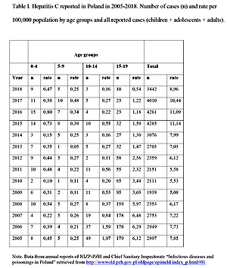

The micro-elimination approach - a new way of tackling hepatitis C in paediatric population
DOI: 10.5114/aoms/138260
Notes:
Recent advances in antiviral drug development towards the hepatitis C virus(HCV) have revolutionized the therapy and paved the way towards the elimi­nation of chronic hepatitis C (CHC). Difficulties in achieving time-bound elimination targets of the World Health Organization’s Global Strategy on viral hepatitis might be overcome through a novel micro-elimination approach. A new, emerging strategy focuses elimination efforts on high-risk and ignored populations, and therefore allows for quick, efficient targeting of treatment and prevention services. So far, gaps in antenatal and/or paedia­tric care, and a lack of reimbursement and approval of direct-acting antivirals (DAA) in the paediatric population have been a barrier to accessing treatment, leading to marginalization of children and adolescents. Recently approved DAAs for use in children aged ≥ 3 years seem to be the cornerstone of HCV elimination by reducing the risk of future horizontal and vertical transmission, firstly on a national, and ultimately on a global level.

