Slide 1
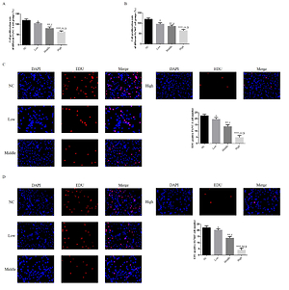

Allicin depresses biological activities of pancreatic cancer cells by regulating miRNA-339-5p/ZNF-689 axis
DOI: 10.5114/aoms/138466
Notes:
Introduction
The aim of this study was to discuss Allicin’s anti-tumor effects and relative in pancreatic cancer cell via vitro and vivo study.
Material and methods
Using PANC-1 and Hs766T cell as research cell lines in our study. The PANC-1 abd GS799T cell were respectively treated with difference concentrations of Allicin. In next step, the PANC-1 abd GS799T cell were transfected with si-miRNA-339-5p which knockdown miRNA-339-5p. The cells were treated with difference concentration of Allicin. Measuring cell proliferation, apoptosis, invasion and migration by MTT, EDU, flow cytometry, TUNEL, transwell and wound healing assay. Relative gene (miRNA-339-5p, ZNF-689, Caspase-3, Caspase-8, E-cadherin and Vimentin) and protein (ZNF-689, Caspase-3, Caspase-8, E-cadherin and Vimentin) expression were evaluated by RT-qPCR and WB assay.
Results
Allicin had effects to suppress PANC-1 and Hs766T cell biological activities including cell proliferation, invasion and migration with cell apoptosis significantly increasing, however, with si-miRNA-339-5p which inhibit miRNA-339-5p expression transfection, the cells biological activities enhancing with cell apoptosis depressing, Compared with NC group, miRNA-339-5p, Caspase-3, Caspase-8 and E-cadherin expression were significantly increased and ZNF-689 and Vimentin expression were significantly depressed in Allicin treated groups, however, with miRNA-339-5p inhibitor transfection, the Allicin’s effects significantly disappear.
Conclusions
Allicin had anti-tumor effect to pancreatic cancer biological activities via regulation miRNA-339-5p/ZNF-689 axis in vitro study.

