Slide 1
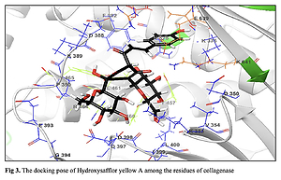

Anti-small cell lung cancer and collagenase inhibition properties of hydroxysafflor yellow A
DOI: 10.5114/aoms/138833
Notes:
Introduction
Hydroxysafflor yellow A is the major active chemical ingredient of Carthamus tinctorius L. (safflower), which is widely used in patients with cardiovascular and cerebrovascular diseases in China.
Material and methods
In our study, the inhibitory effect of hydroxysafflor yellow A on collagenase showed a lower value, IC50 = 78.81 µg/ml. In the cellular and molecular part of the recent study, the cells treated with hydroxysafflor yellow A were assessed by MTT assay for 48 h as regards the cytotoxicity and anti-small cell lung cancer effects on SBC-3, DMS273, and DMS114 cell lines.
Results
The viability of small cell lung cancer cell lines decreased dose-dependently in the presence of hydroxysafflor yellow A. The IC50 values of hydroxysafflor yellow A were 539, 432, and 416 µg/ml against SBC-3, DMS273, and DMS114 cell lines, respectively. A molecular docking study was carried out for evaluation of the biological activity of hydroxysafflor yellow A against the collagenase H from Clostridium histolyticum.
Conclusions
The results of the docking calculations revealed the considerable binding affinity of the inhibitor to the enzyme with a docking score of –9.238 (kcal/mol). This remarkable binding affinity could be attributed to the number of hydrogen bonds and hydrophobic contacts, which are 6 and 10, respectively.

