Slide 1
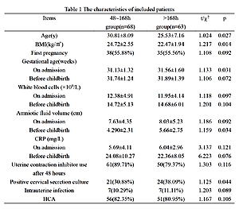

The role of latency period on the preterm premature rupture of membranes: implication for treatment
DOI: 10.5114/aoms/139314
Notes:
Introduction
Conservative treatments with a latency period have been used for the treatment of preterm premature rupture of membranes (PPROM) in clinical practice. We aimed to evaluate the role and potential influencing factors of the latency period, to provide insights for the clinical treatment of PPROM.
Material and methods
PPROM pregnant women treated in our hospital from January 1, 2015 to September 30, 2020 were included. PPROM patients were divided into a 48–168 h group and a > 168 h latency group; the characteristics and prognosis of these two groups were compared and analyzed. Logistic regression analyses were conducted to analyze the relevant influencing factors of the latency period.
Results
A total of 131 PPROM patients were included. There were significant differences in the age, BMI, gestational age on admission, amniotic fluid volume before childbirth, and positive rate of cervical secretion culture between the two groups (all p < 0.05). Logistic regression analyses indicated that the latency period was shorter in the PPROM patients with age ≥ 30 years (OR = 0.048, 95% CI: 0.121–0.863) and gestational age ≥ 32 weeks on admission (OR = 0.463, 95% CI: 0.069–0.811), and the latency period was prolonged in the PPROM patients with BMI ≥ 23 kg/m2 (OR = 1.591, 95% CI: 1.134–1.944) and amniotic fluid volume ≥ 6 cm (OR = 2.129, 95% CI: 1.093–3.042) (all p < 0.05). There were significant differences in the incidence of low birth weight and neonatal respiratory distress syndrome (NRDS) between the 48–168 h group and > 168 h group (all p < 0.05).
Conclusions
The latency period plays an important role in PPROM, which is associated with the pregnant women’s age, BMI, gestational week of rupture and amniotic fluid index.

