Slide 1
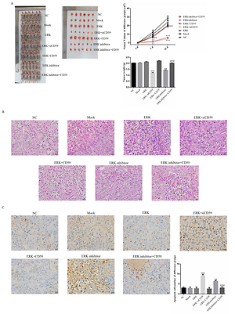

ERK knockdown suppresses cell biological activities via regulation of CD59 in breast cancer
DOI: 10.5114/aoms/139683
Notes:
Introduction
The purpose of this study was to investigate the effect of extracellular signal-regulated kinase (ERK) in breast cancer and the related mechanisms.
Material and methods
Some previous studies found that ERK was closely correlated with CD59 in cancer. In our clinical study, we evaluated ERK and CD59 protein expression in different tissue from patients by immunohistochemical (IHC) assay using MCF-7 and MDA-MB-231 cell lines which were breast cancer cell lines as target cell lines. We performed an <i>in vitro</i> study, evaluating cell biological activities including proliferation, apoptosis, cell cycle, invasion, adherent and migration by MTT, clone test, TUNEL assay, flow cytometry and wound healing, and measuring relative protein expression by WB assay. In an <i>in vivo</i> study, measuring tumor weight and volume, the apoptosis cell number was evaluated by TUNEL assay and relative protein expression by IHC assay.
Results
Compared with adjacent normal tissue, the ERK and CD59 protein expression levels were significantly increased in breast cancer tissues (both <i>p</i> < 0.001). In <i>in vitro</i> and <i>in vivo</i> studies, with ERK knockdown, the cell biological activities were significantly depressed with CD59 suppression (both <i>p</i> < 0.001). Also the relative protein levels including CD59, PKD, P53, E-cadherin and vimentin were significantly different (each <i>p</i> < 0.001).
Conclusions
ERK act as an oncology gene in breast cancer development. ERK inhibitor suppressed breast cancer biologically via regulation of CD59 <i>in vitro</i> and <i>in vivo</i>.

