Slide 1
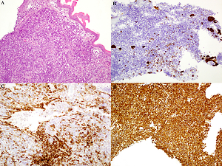

Malignant mixed Müllerian tumour of the uterus associated with non-islet cell tumour hypoglycaemia
DOI: 10.5114/aoms/140296
Arch Med Sci 2021;17(5):1433-1435

