Slide 1
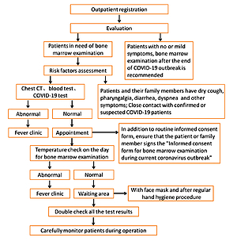

A new workflow on bone marrow aspiration and biopsy during the COVID-19 pandemic
DOI: 10.5114/aoms/140395
Arch Med Sci 2021;17(5):1429-1432

