Slide 1
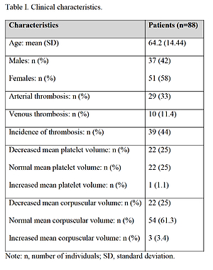

Genetic factors that may affect the risk of developing thrombosis in patients with myeloproliferative disorders
DOI: 10.5114/aoms/140399
Notes:
Introduction
Patients with Philadelphia-negative (Ph-) myeloproliferative neoplasms: primary myelofibrosis, essential thrombocythemia and polycythemia vera; often develop thrombotic events. It was suggested that the genetic variants that are responsible for blood coagulation and elevated homocysteine level play causal role in the occurrence of thrombosis. Our aim was to evaluate the single nucleotide polymorphisms in PROS1, EPCR, PROC, MTHFR, MS genes and their associations with the risk of developing thrombosis as well as clinical characteristics in patients with myeloproliferative disorders.
Material and methods
The screening of PROS1 g.66847T>C, EPCR c.4678G>C, EPCR c.6936A>G, PROC c.565C>T, MTHFR c.677C>T, MTHFR c.1298A>C, MS c.2756A>G polymorphisms was performed at Lithuanian University of Health Sciences, Kaunas, Lithuania. The PCR-RFLP method was applied.
Results
After genotyping 88 patients with Ph- myeloproliferative disorders, the association was found between venous thrombosis and MTHFR c.1298A>C (p=0.019). Regression analysis revealed that carriers of PROS1 66847TC, EPCR 4678GC, 6936AG or GG, PROC 565CT or TT, MTHFR 677CT, MS 2756AG genotypes were associated with a lower risk of developing venous thrombosis. EPCR 6936AG genotype could be considered as a protective factor against arterial thrombosis. Genotypes PROC 565CT and 565TT were associated with a lower risk of decreased levels of MPV, 565TT carriers were less likely to develop arterial or venous thrombosis, compared with those carrying the CC or CT genotype.
Conclusions
It can be concluded that more research into these polymorphisms needs to be performed, since there are many conflicting results published regarding the complexity of the possible interactions between these gene variants and predisposition to thrombotic events.

