Slide 1
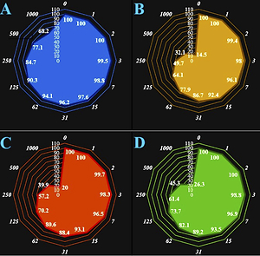

Anti-human ovarian cancer, cytotoxicity, and antioxidant effects of Nigella sativa green-formulated Au nanoparticles: describing a new chemotherapeutic supplement
DOI: 10.5114/aoms/140492
Notes:
Introduction
This research showed that gold nanoparticles (GNPs) formulated with Nigella sativa aqueous extract have potent antioxidant and anti-human ovarian cancer activities in in vitro conditions.
Material and methods
To determine the properties of the GNPs that were produced from the reaction between gold chloride solution and aqueous Nigella sativa extract, we used UV-visible spectroscopy (UV-Vis), field emission scanning electron microscopy (FE‐SEM), Fourier transform infrared spectroscopy (FT‐IR), and transmission electron microscopy (TEM). For evaluating anti-ovarian cancer and cytotoxicity effects of GNPs, Au chloride, and Nigella sativa aqueous extract, we used the MTT assay.
Results
The results of this test showed that GNPs have no cytotoxicity on a normal cell line (HUVEC) and have potent anti-ovarian cancer features dose-dependently against PA-1, SK-OV-3, and SW-626 cell lines. The IC50 values of GNPs were 249, 361, and 433 µg/ml against PA-1, SW-626, and SK-OV-3 cell lines, respectively. For evaluating the antioxidant features of GNPs, Au chloride, and Nigella sativa aqueous extract, we used the DPPH test; in this test butylated hydroxytoluene was a positive control; the results of this test showed that the GNPs have an effective antioxidant action. In the antioxidant test, the IC50 values of GNPs and BHT were 144 and 201 µg/ml, respectively.
Conclusions
Probably, potent anti-human ovarian cancer activities of GNPs formulated with Nigella sativa aqueous seed extract are due to antioxidant properties. After evaluating the effectiveness of this formulation in clinical trial research, it can be a good alternative to chemotherapy drugs.

