Slide 1
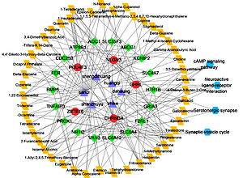

Mechanism of tangshen formula in treating diabetic nephropathy revealed by network pharmacology approach
DOI: 10.5114/aoms/140544
Arch Med Sci 2021;17(5):1436-1439

