Slide 1
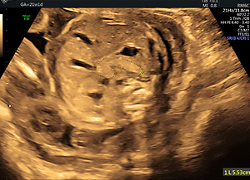

Sonographic measurement of the fetal pancreas in women with gestational diabetes
DOI: 10.5114/aoms/140578
Arch Med Sci 2022;18(2):382-387
Notes:
Introduction
Maternal glycemic state is positively correlated with fetal insulin secretion. Randomized control studies have shown that treatment during pregnancy inhibits to some degree this glycemic effect. Our study aimed to assess fetal pancreas size in a population of treated mothers with gestational diabetes.
Material and methods
A cross-sectional, prospective observational study was conducted. Pregnant women at 19–36 weeks of gestation with pre-gestational diabetes receiving insulin therapy or with gestational diabetes receiving either insulin or oral hypoglycemic therapy were recruited. The fetal pancreas circumference was measured and compared to the normal reference range. The Z score of the difference between measured and normal predicted mean pancreas circumference, the regression analysis throughout pregnancy, and the correlation between estimated fetal weight centile and pancreas circumference were calculated.
Results
Ninety-one women who had gestational diabetes and thirty-four women who had pre-gestational diabetes were included in the study. For both groups, fetal pancreas circumference correlated significantly with abdominal circumference, estimated fetal weight and gestational age. The mean Z score between the predicted pancreas circumference in the group of women diagnosed with gestational diabetes and the predicted pancreas circumference in a normal population peaked at around 24 weeks of gestation (1.1) and decreased gradually afterward to a value of zero at 37 weeks. The mean Z score between the predicted pancreas circumference in the group of women with pre-gestational diabetes and the predicted pancreas circumference in a normal population constantly decreased with duration of pregnancy. It was positive until the 25th week of gestation and then presented negative values towards the term.
Conclusions
The presented preliminary data suggest a possible correlation between glycemic control treatment, pancreas size, and gestational age.

