Slide 1
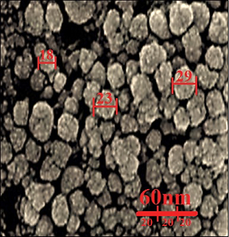

Novel formulation, cytotoxicity, antioxidant, and anti-human lung cancer properties of gold nanoparticles containing Verbascum thapsus L. leaf aqueous extract
DOI: 10.5114/aoms/141043
Notes:
Introduction
In the present study, gold nanoparticles were prepared and synthesized in aqueous medium using Verbascum thapsus leaf extract. We assessed the anti-human lung cancer potential of these nanoparticles against well-differentiated bronchogenic adenocarcinoma, moderately differentiated adenocarcinoma of the lung, and poorly differentiated adenocarcinoma of the lung cell lines.
Material and methods
AuNPs were characterized and analyzed by common nanotechnology techniques including Fourier transform infrared (FT-IR) and ultraviolet-visible (UV-Vis) spectroscopy, field emission-scanning electron microscopy, and transmission electron microscopy. In the FT-IR test, the presence of many antioxidant compounds with related bonds caused excellent conditions for reduction of gold in the gold nanoparticles. In UV-Vis, the clear peak at the wavelength of 548 nm indicated the formation of gold nanoparticles. For determining anti-human lung cancer properties of HAuCl4, V. thapsus, and AuNPs, MTT assay was used on normal (HUVECs), well-differentiated bronchogenic adenocarcinoma (HLC-1), moderately differentiated adenocarcinoma of the lung (LC-2/ad), and poorly differentiated adenocarcinoma of the lung (PC-14) cell lines.
Results
AuNPs had excellent anti-human lung cancer effects dose-dependently against HLC-1, LC-2/ad, and PC-14 cell lines. The best result of anti-human lung cancer activities of AuNPs against the above cell lines was observed in the case of the PC-14 cell line.
Conclusions
The synthesized AuNPs showed significant anti-human lung cancer properties against well-differentiated bronchogenic adenocarcinoma, moderately differentiated adenocarcinoma of the lung, and poorly differentiated adenocarcinoma of the lung cell lines in a dose-dependent manner.

