Slide 1
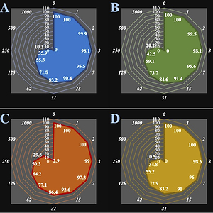

Introducing a novel chemotherapeutic drug formulated with anthraflavic acid for treating human breast carcinoma and type 2 diabetes mellitus
DOI: 10.5114/aoms/141173
Arch Med Sci 2023;19(6):1850-1858
Notes:
Introduction
Molecular docking as a versatile theoretical method was used to investigate the biological activities of anthraflavic acid in the presence of α-amylase. The outcomes revealed that anthraflavic acid has a considerable binding affinity to the enzyme with a docking score of –7.913 kcal/mol. These outcomes were further evaluated with free binding energy calculations, and it was concluded that anthraflavic acid could be a potential inhibitor for α-amylase.
Material and methods
Anthraflavic acid was explored in anti-human breast carcinoma tests. The in vitro cytotoxic and anti-breast carcinoma effects of biologically synthesized anthraflavic acid against MCF-7, CAMA-1, SK-BR-3, MDA-MB-231, AU565 [AU-565], and Hs 281.T cancer cell lines were assessed. In the 3-(4,5-dimethylthiazol-2-yl)-2,5-diphenyl-2H-tetrazolium bromide (MTT) assay, the anti-breast carcinoma properties of anthraflavic acid could significantly kill the MCF-7, CAMA-1, SK-BR-3, MDA-MB-231, AU565 [AU-565], and Hs 281.T cancer cell lines in a time- and concentration-dependent manner. Also, we used human umbilical vein endothelial cells (HUVECs) to determine the cytotoxicity potentials of anthraflavic acid using MTT assay.
Results
The IC<sub>50</sub> values of anthraflavic acid were 159, 193, 253, 156, 241, and 218 µg/ml against MCF-7, CAMA-1, SK-BR-3, MDA-MB-231, AU565 [AU-565], and Hs 281.T cancer cell lines.
Conclusions
It seems the anti-human breast carcinoma effect of recent nanoparticles is due to their antioxidant effects.

