Slide 1
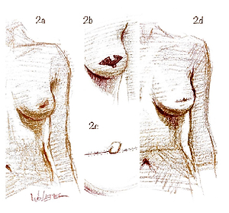

A novel technique for immediate nipple reconstruction with a rectangular flap in implant-based breast reconstruction
DOI: 10.5114/aoms/141229
Arch Med Sci 2025;21(1):153-159
Notes:
Introduction
Nipple reconstruction complements breast mound restoration in postmastectomy breast cancer patients. It positively affects patients’ welfare, both in psycho-social and sexual aspects. An immediate nipple reconstruction is an alternative approach to delayed surgery. We describe an original technique for an immediate nipple reconstruction using a modified rectangular flap.
Material and methods
One hundred and seventeen nipple reconstructions in 112 breast cancer patients were performed. This technique was used during skin-sparing mastectomy, including 104 (88.9%) implants and 13 (11.1%) tissue-expander breast reconstructions. Synthetic meshes covered with titanium supported lower breast poles in 72 (61.5%) implantations; in the remaining cases (38.5%), muscles covered the entire implant. Preoperative chemotherapy was applied in 18.75% of the patients; adjuvant chemo- and hormonal therapy were applied in 29.5% and 74.1% of the patients, respectively. Twenty-four (21.4%) patients were irradiated postoperatively.
Results
In 5 (4.3%) out of 117 procedures, necrosis of the rectangular flap was observed. Twelve months after surgery, 2 (1.7%) cases of loss of projection of the reconstructed nipple were reported. In the twelfth month of observation, of the subgroup of 102 patients with permanent nipple presentation, 93.1% gave a positive opinion regarding the procedure.
Conclusions
The applied immediate nipple reconstruction technique performed during a skin-sparing mastectomy and implant/expander-based breast reconstruction was an effective and safe adjunct curative breast surgery.

