Slide 1
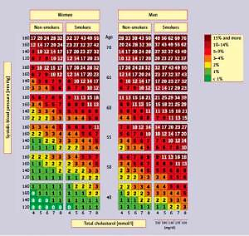

PoLA/CFPiP/PCS/PSLD/PSD/PSH guidelines on diagnosis and therapy of lipid disorders in Poland 2021
DOI: 10.5114/aoms/141941
Arch Med Sci 2021;17(6):1447-1547
Notes:
In Poland there are still nearly 20 million individuals with hypercholesterolaemia, most of them are unaware of their condition; that is also why only ca. 5% of patients with familial hypercholesterolaemia have been diagnosed; that is why other rare cholesterol metabolism disorders are so rarely diagnosed in Poland. Let us hope that these guidelines, being an effect of work of experts representing 6 main scientific societies, as well as the network of PoLA lipid centers being a part of the EAS lipid centers, certification of lipidologists by PoLA, or the growing number of centers for rare diseases, with a network planned by the Ministry of Health, improvements in coordinated care for patients after myocardial infarction (KOS-Zawał), reimbursement of innovative agents, as well as introduction in Poland of an effective primary prevention program, will make improvement in relation to these unmet needs in diagnostics and treatment of lipid disorders possible.

