Slide 1
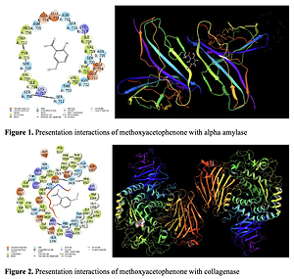

Anti-ovarian cancer and collagenase, α-amylase, and aldose reductase inhibition properties of 2'-hydroxy-5'-methoxyacetophenone with molecular modeling studies
DOI: 10.5114/aoms/142405
Notes:
Introduction
This work investigated the inhibition effect of 2'-hydroxy-5'-methoxyacetophenone on aldose reductase, α-amylase, and also collagenase enzymes. Also, molecular modeling calculations were performed comparing the biochemical activity of the 2'-hydroxy-5'-methoxyacetophenone molecule with these enzymes.
Material and methods
The enzymes used in these calculations are aldose reductase (AR), α-amylase (Alpha-Amy), and collagenase from Clostridium histolyticum (Coll). After the docking calculations were performed, ADME/T analysis parameters were examined in order to calculate the properties of the methoxyacetophenone molecule to be utilized as a drug in the future. For determining anti-ovarian cancer properties of 2'-hydroxy-5'-methoxyacetophenone, the MTT assay was used on normal (HUVEC), PA-1, Caov-3, and SK-OV-3 cell lines.
Results
The IC50 values of 2'-hydroxy-5'-methoxyacetophenone against PA-1, Caov-3, and SK-OV-3 cell lines were found to be 271, 326 and 405 µg/ml, respectively.
Conclusions
2'-hydroxy-5'-methoxyacetophenone was found to have significant antioxidant and anti-ovarian cancer properties. It appears that the anti-ovarian cancer effect of 2'-hydroxy-5'-methoxyacetophenone is due to its antioxidant effects.

