Slide 1
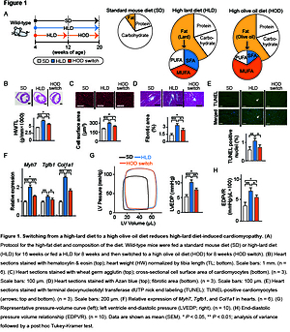

Saturated fatty acid-induced cardiomyopathy with diastolic dysfunction can be ameliorated by changing the quality of fatty acids to monounsaturated fatty acid
DOI: 10.5114/aoms/142428
Notes:
Introduction
Lipotoxicity due to obesity is known to lead to cardiac dysfunction. In an earlier study, we found that an increase in the ratio of saturated fatty acids (SFA) to monounsaturated fatty acids (MUFA) in the membrane of cardiomyocytes causes endoplasmic reticulum (ER) stress. Such stress is hypothesized to be involved in development of SFA-related cardiomyopathy. Another factor affecting the membrane SFA/MUFA ratio is suppression by SFA of SIRT1-mediated stearoyl-CoA desaturase-1 (SCD1), which is involved in converting SFA to MUFA. Therefore, we evaluated whether increasing dietary intake of MUFA can improve the membrane SFA/MUFA ratio.
Material and methods
Wild-type mice (n = 30) and cardiomyocyte-specific SIRT1 knockout mice (n = 30) were randomly divided into 3 groups and assigned to 16 weeks of a standard mouse diet, 16 weeks of an SFA-rich high-lard diet (HLD), or 8 weeks of a HLD followed by 8 weeks of a MUFA-rich high olive oil diet (HOD switch).
Results
Compared with the control group, the wild-type mice on the HOD diet showed normalized SIRT1-mediated SCD1 signaling, increased membrane SFA/MUFA ratio, decreased ER stress, and improved cardiomyopathy variables. The HLD-fed SIRT1 knockout mice showed greater changes in the SFA/MUFA ratio, ER stress, and cardiomyopathy variables than the wild-type mice. Switching from HLD to HOD ameliorated these phenotypes, although it did not restore the reduced expression of SCD1.
Conclusions
The MUFA-rich diet was found to have a therapeutic effect on SFA-induced cardiomyopathy with diastolic dysfunction by directly rebalancing membrane fatty acid oversaturation and indirectly through the de-inhibition of SIRT1/SCD1 signaling.

