Slide 1
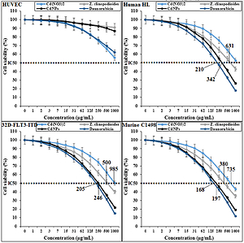

Anti-leukemia properties of cadmium nanoparticles in <i>in vitro</i> and <i>in vivo</i> conditions: a chemobiological study
DOI: 10.5114/aoms/142465
Notes:
Introduction
The present study investigated the anti-acute myeloid leukemia effects of <i>Ziziphora clinopodioides</i> Lam leaf aqueous extract conjugated cadmium nanoparticles.
Material and methods
To synthesize cadmium nanoparticles (CdNPs), Z. clinopodioides aqueous extract was mixed with Cd(NO<sub>3</sub>)<sub>2</sub> . 4 H<sub>2</sub>O. The characterization of the biosynthesized cadmium nanoparticles was carried out using many various techniques such as UV-Vis. and FT-IR spectroscopy, XRD, FE-SEM, and EDS.
Results
The uniform spherical morphology of NPs was proved by FE-SEM images with NPs the average size of 26.78 nm. For investigating the antioxidant properties of Cd(NO<sub>3</sub>)<sub>2</sub>, <i>Z. clinopodioides</i>, CdNPs, and daunorubicin, the DPPH test was used. The cadmium nanoparticles inhibited half of the DPPH molecules in a concentration of 196 µg/ml. To survey the cytotoxicity and anti-acute myeloid leukemia effects of Cd(NO<sub>3</sub>)<sub>2</sub>, Z. clinopodioides, CdNPs, and daunorubicin, MTT assay was used on the human acute myeloid leukemia cell lines i.e., murine C1498, 32D-FLT3-ITD, and Human HL-60/vcr. The IC<sub>50</sub> of the cadmium nanoparticles was 168, 205, and 210 µg/ml against murine C1498, 32D-FLT3-ITD, and human HL-60/vcr cell lines, respectively. In the in vivo part of the study, DMBA was used for inducing acute myeloid leukemia in mice. CdNPs, similar to daunorubicin, ameliorated significantly (<i>p</i> ≤ 0.01) the biochemical, inflammatory, RBC, WBC, platelet, stereological, histopathological, and cellular-molecular parameters compared to the other groups.
Conclusions
The cadmium nanoparticles had significant anti-acute myeloid leukemia effects. After approving the above results in the clinical trial studies, these cadmium nanoparticles can be used as a chemotherapeutic drug to treat acute myeloid leukemia in humans.

