Slide 1
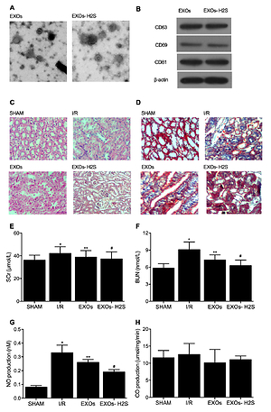

H<sub>2</sub>S treatment improves protective effect of mesenchymal stem cell-derived exosomes on renal ischemia/reperfusion fibrosis by suppressing inflammatory signaling of TGF-β and NF-κB as well as radical oxygen species generation
DOI: 10.5114/aoms/142601
Notes:
Introduction
Hydrogen sulfide (H<sub>2</sub>S) has been reported to regulate signaling pathways responsible for development of renal ischemia/reperfusion (I/R) associated fibrosis. In this study, we hypothesized that preconditioning with H<sub>2</sub>S may boost the protective effect of mesenchymal stem cells- (MSC) -derived exosomes (EXOs) on renal I/R fibrosis.
Material and methods
Real-time polymerase chain reaction (PCR) and Western blot were performed to evaluate mRNA and protein expression of Nrf2, NF-κB, TGF-β, α-SMA, and collagen type II (Col2). H & E and Masson staining were carried out to examine the kidney injury and fibrosis in rats.
Results
H<sub>2</sub>S-preconditioned EXOs substantially promoted the protective effect of EXOs on the development of kidney injury as well as associated fibrosis in I/R rats.EXO treatment significantly restored the activated gene and protein expression of NF-κB, TGF-β, α-SMA, and Col2 in I/R rats and the cellular model of hypoxia/reoxygenation (H/R), while H2S preconditioning remarkably strengthened this effect of EXOs. Additionally, H2S preconditioning remarkably strengthened the efficiency of EXOs in restoring the activated expression of IL-1α, IL-6, IL-12 and TNF-β as well as altered activities of superoxide dismutase (SOD), malondialdehyde (MDA), H<sub>2</sub>O<sub>2</sub>, glutathione S-transferase (GST) and glutathione peroxidase (GPx) in I/R rats and the cellular model of H/R.
Conclusions
This study utilized I/R rats to demonstrate that the effect of H<sub>2</sub>S-preconditioned exosomes in suppressing inflammation and radical oxygen species (ROS) generation was better than that of unconditioned exosomes. To be specific, exosomes, especially H<sub>2</sub>S-preconditioned exosomes, could not only reduce the expression of NF-κB and the downstream inflammatory responses, but also promote the expression of Nrf2 and inhibit ROS generation, which explained the molecular mechanism underlying the protective effect of H<sub>2</sub>S-preconditioned exosomes on renal I/R associated fibrosis.

