Slide 1
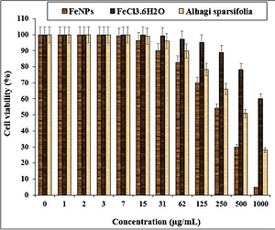

Biosynthesis of iron nanoparticles using <i>Alhagi sparsifolia</i> extract for treatment of colorectal carcinoma in in vitro conditions: a pre-clinical trial study
DOI: 10.5114/aoms/143052
Notes:
Introduction
Every year, many people die due to cancer all over the world. So, the development of effective new chemotherapeutic supplements and drugs for the treatment of cancer is a priority for both developing and developed countries. Recently, iron nanoparticles (FeNPs) have been used as modern chemotherapeutic drugs for the treatment of several cancers such as leukemia, lung cancer, breast cancer, and prostate cancer.
Material and methods
In the present study, iron nanoparticles were green-synthesized using an aqueous extract of Alhagi sparsifolia leaf. The synthesized FeNPs were characterized by analytical techniques including SEM, TEM, UV-Vis, and FT-IR.
Results
The nanoparticles were formed in a spherical shape in the average size of 47.24 nm. In the antioxidant test, the IC50 values of FeNPs and BHT against DPPH free radicals were 161 and 134 µg/ml, respectively. The anti-human colorectal carcinoma activity of FeNPs was evaluated using MTT assay. In the cellular and molecular part of the recent study, the cells treated with FeNPs were assessed by MTT assay for 48 h about the cytotoxicity and anti-human colorectal carcinoma properties on normal (HUVEC) and colorectal carcinoma cell lines, i.e. HT-29, HCT 116, HCT-8, and Ramos.2G6.4C10. The viability of the malignant colorectal cell line decreased dose-dependently in the presence of FeNPs. The IC50 of FeNPs were 250, 293, 276, and 344 µg/ml against HT-29, HCT 116, HCT-8, and Ramos.2G6.4C10 cell lines, respectively.
Conclusions
After clinical study, iron nanoparticles containing Alhagi sparsifolia leaf aqueous extract may be used to formulate a new chemotherapeutic drug or supplement to treat the several types of human colorectal carcinoma.

