Slide 1
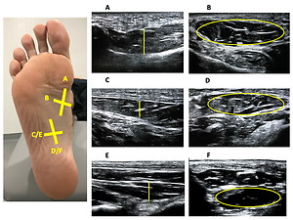

Ultrasonographic features of the intrinsic foot muscles in patients with and without plantar fasciitis: a novel case-control research study
DOI: 10.5114/aoms/143122
Notes:
Introduction
The aim of the present study was to compare by ultrasound imaging (USI) the thickness and cross-sectional area (CSA) of the flexor hallucis brevis (FHB), flexor digitorum brevis (FDB), abductor hallucis brevis (AHB) and quadratus plantae (QP) muscles between individuals with and without plantar fasciitis (PF).
Material and methods
A case-control study was performed with 64 participants divided into two groups: A, PF group (n = 32) and B, healthy group (n = 32).
Results
USI measurements for FHB CSA (p = 0.035) decreased, showing statistically significant differences for the PF group, while the QP CSA (p = 0.40) increased, showing statistically significant differences for the PF group with respect to the healthy group. The rest of the intrinsic foot muscles (IFM) did not show statistically significant differences; however in FHB, FDB, QP and AHB thicknesses and FDB CSA showed a slightly decrease for the PF group.
Conclusions
USI measurements showed that the CSA of the FHB muscle is reduced in patients with PF while the CSA of the QP muscle is increased in patients with PF.

