Slide 1
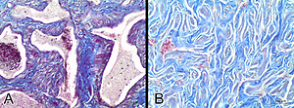

Changes in the extracellular matrix of the clitoris caused by aging: a stereological and comparative study
DOI: 10.5114/aoms/143150
Arch Med Sci 2021;17(6):1816-1818
Notes:
Introduction
The clitoris is partially responsible for sexual arousal. The integrity of the extracellular matrix is essential for clitoral erection. Sexual dysfunction is a phenomenon associated with age.
Material and methods
The clitoris of cadavers of 20- to 80-year-old women was excised and histologically processed. Stereological analysis was performed to quantify the volumetric density of collagen, elastic fibers, and smooth muscle.
Results
A significant increase in collagen and a decrease in smooth muscle and elastic fibers were observed in older women.
Conclusions
In short, these changes caused by aging could contribute to female sexual dysfunction concerning clitoral orgasm.

