Slide 1
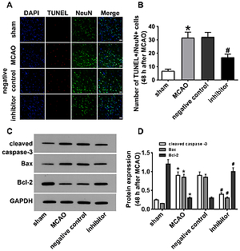

Inhibition of miR-34a ameliorates cerebral ischemia/reperfusion injury by targeting brain-derived neurotrophic factor
DOI: 10.5114/aoms/143303
Notes:
Introduction
Oxidative stress and neuronal apoptosis are strongly associated with the pathogenesis of ischemic stroke. In this study, we aimed to determine whether miR-34a was involved in ischemia/reperfusion (I/R) injury, oxidative stress, and neuronal apoptosis by targeting brain-derived neurotrophic factor (BDNF).
Material and methods
Rats received middle cerebral artery occlusion (MCAO) surgery to simulate I/R injury. At 24 h after MCAO surgery, neurological deficits and infarct volumes were evaluated according to Longa’s scale and 2,3,5-triphenyltetrazolium (TTC) chloride staining. Neuronal apoptosis was assessed by terminal deoxynucleotidyl transferase-mediated dUTP nick-end labeling (TUNEL), and the expression of miR-34a and associated proteins were detected by quantitative reverse-transcription polymerase chain reaction (qRT-PCR), and western blotting. Several markers of oxidative stress were detected using commercial kits, and the interaction between miR-34a and BDNF was measured by RNA immunoprecipitation (RIP).
Results
The results showed that miR-34a was upregulated (p < 0.05), whereas BDNF was downregulated (p < 0.05) in the MCAO rats, and this negative correlation was accompanied by clear oxidative stress and neuronal apoptosis. RIP demonstrated a clear interaction between miR-34a and BDNF. Furthermore, miR-34a was also found to inhibit oxidative stress and neuronal apoptosis, increase BDNF expression, and ameliorate neurological deficits and infarct volumes (p < 0.05) seen in the MCAO rats.
Conclusions
These data suggested that inhibition of miR-34a ameliorated cerebral ischemia/reperfusion injury by targeting BDNF. This mechanism represents a novel and promising target for the treatment of strokes.

