Slide 1
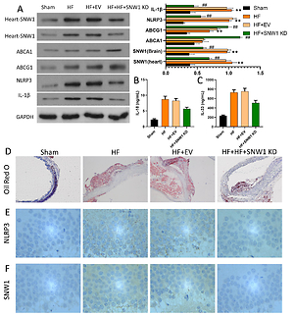

Knockdown of SNW1 ameliorates brain microvascular endothelial cells injury by inhibiting NLRP3 inflammasome activation
DOI: 10.5114/aoms/143514
Notes:
Introduction
SNW domain containing 1 (SNW1), as a splicing factor to regulate the activity of transcription factors, has been reported to be involved in multiple disease processes, including neuroblastoma. Whereas, the latent function and concrete mechanism of SNW1 in brain microvascular endothelial cells (BMECs) have not been clarified.
Material and methods
BMECs were induced by oxidized low-density lipoprotein (ox-LDL), and high fat (HF)-fed rats were established. After SNW1 knockdown or NLR family pyrin domain containing 3 (NLRP3) overexpression, SNW1 and NLRP3 expressions were monitored via RT-qPCR, Western blot, or immunohistochemistry assays. Also, cell viability, apoptosis, and cholesterol efflux were determined via CCK-8, flow cytometry, and related kits; IL-18 and IL-3 levels were also certified by ELISA kits; and NLRP3 inflammasomes and cholesterol efflux-related proteins were identified by Western blot in vitro and in vivo.
Results
We discovered that ox-LDL or HF-feeding significantly elevated SNW1 and NLRP3 expressions, and prominently induced BMECs injury in BMECs or rat brain tissues. Subsequently, our data confirmed that SNW1 knockdown markedly accelerated cholesterol efflux and viability, and prevented apoptosis and NLRP3 inflammasomes, which also could be reversed by NLRP3 overexpression in ox-LDL-induced BMECs. In addition, we showed that SNW1 knockdown could signally induce cholesterol efflux and repress NLRP3 inflammasome activation in HF-fed rats.
Conclusions
We demonstrated that SNW1 knockdown has a great protection effect on the dysfunction of BMECs by inhibiting NLRP3. So, SNW1 might be a therapeutic target for BMECs injury.

