Slide 1
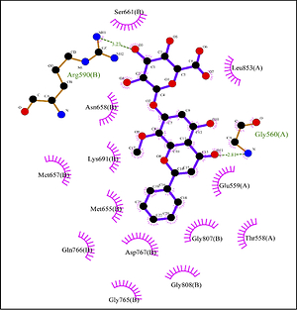

Wogonoside: anti-human colon cancer activities and survey of HMG-CoA reductase inhibition properties with molecular modeling
DOI: 10.5114/aoms/143792
Notes:
Introduction
The biological activities and interactions of wogonoside in the presence of HMG-COA reductase were investigated using a molecular docking study as a versatile theoretical approach. Wogonoside showed a considerable binding affinity to the enzyme with a docking score of –7.582 kcal/mol. The results indicated that the compound makes hydrophobic contacts with essential residues of the catalytic domain of the enzyme. Therefore, wogonoside could be considered as a potential inhibitor for HMG-COA reductase.
Material and methods
The in vitro cytotoxic and anti-colon carcinoma effects of biologically synthesized wogonoside against GP5d, MDST8, HCA-46, HT115, LS174T, and COLO 320DM cancer cell lines were assessed. The IC50 of wogonoside were 105, 198, 173, 382, 71, and 183 µg/ml against GP5d, MDST8, HCA-46, HT115, LS174T, and COLO 320DM cancer cell lines.
Results
The anti-colon carcinoma properties of wogonoside could significantly remove GP5d, MDST8, HCA-46, HT115, LS174T, and COLO 320DM cancer cell lines in a time- and concentration-dependent manner by MTT assay. It appears that the anti-human colon carcinoma effect of recent nanoparticles is due to their antioxidant effects. We obtained results for the HMG-CoA reductase enzyme at the micromolar level. In our study, the inhibition result for HMG-CoA reductase showed a lower micromolar value of 28.70±4.73.
Conclusions
The results showed that Wogonoside has a good affinity with hmG-COA reductase binding site, and it is a promising HMG-COA reductase inhibitor, which has a certain potential in the treatment of colon carcinoma in humans in clinical patients.

