Slide 1
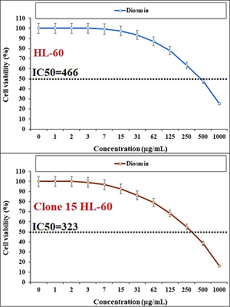

Describing a novel chemotherapeutic drug formulated with diosmin for treatment of acute lymphoblastic leukemia and diabetes mellitus
DOI: 10.5114/aoms/144053
Notes:
Introduction
Diosmin is a natural citrus flavone with remarkable antioxidant and anti-inflammatory features. Acute leukemia is a common type of cancer that is caused in the blood.
Material and methods
α-Amylase activity was determined by a method adapted from the work of Taha et al.
Results
In this study, we examined its effect on some important enzymes, the IC<sub>50</sub> values were 196.07 for Aldose reductase, and 76.40 for α-Amylase. The molecular docking study was performed to assess the binding affinity and biological activities of diosmin in the presence of alpha amylase and aldose reductase.
Discussion
The results of the docking study indicated that diosmin has a remarkable binding affinity to these enzymes with a docking score of –9.768 and –140469 for α-amylase and aldose reductase, respectively. Therefore, this compound could be used as a potential inhibitor for these enzymes. In the cellular and molecular part of the recent study, the cells treated with diosmin were assessed by MTT assay for 48 h regarding the cytotoxicity and anti-human acute lymphoblastic leukemia properties on HL-60, Clone 15 HL-60, HL-60/MX1, and HL-60/MX2 cell lines. The IC<sub>50</sub> values of diosmin were 466, 323, 502, and 537 µg/ml against HL-60, Clone 15 HL-60, HL-60/MX1, and HL-60/MX2 cell lines, respectively.
Conclussions
The viability of acute lymphoblastic leukemia cell lines decreased dose-dependently in the presence of diosmin. It appears that the anti-human acute lymphoblastic leukemia effect of diosmin is due to its antioxidant effects.

