Slide 1
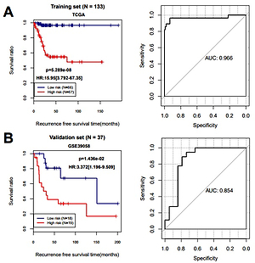

Genome-wide analysis of lncRNAs, miRNAs and mRNAs forming a prognostic scoring model associated with the recurrence of osteosarcoma
DOI: 10.5114/aoms/144103
Notes:
Introduction
Purpose: Among young adults and adolescents, the most common malignant bone tumor is osteosarcoma (OS). Even patients who are cured by surgery or neoadjuvant chemotherapy still have a high possibility of recurrence. In recent years, due to the development of molecular biology research methods, many new prognostic markers based on the gene level have emerged. In addition, the mutual regulation mode among long non-coding RNA (lncRNA), miRNA and target genes are closely related to the occurrence and development of tumors. In our research, we aimed to analyze the molecular regulation mode and predict clinical outcomes by integrate three types of RNA expression.
Material and methods
Materials and Methods: We obtained the data of OS patients from The Cancer Genome Atlas (TCGA) database including expression data (RNA and miRNA expression data) and clinical data.
Results
Results: After differential gene expression analysis, Cox regression analysis and functional enrichment analysis, 1 lncRNA, 3 miRNAs and 9 mRNAs were identified as prognostic RNA. We constructed the prognostic scoring (PS) model with high predicting prognosis performance. Using PS models and clinical data, we established a nomogram to calculate patients' 3-year and 5-year survival rates.
Conclusions
Conclusions: Finally, competing endogenous RNAs (ceRNAs) network and functional enrichment analysis help us to understand molecular mechanisms associated with the recurrence of osteosarcoma.

