Slide 1
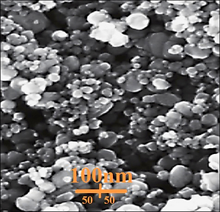

Green formulation and characterization of Fe nanoparticles containing <i>Calendula</i> extract and investigation of the antioxidant, cytotoxic and anti-human cholangiocarcinoma properties
DOI: 10.5114/aoms/144183
Notes:
Introduction
Among the simplest nanostructures that are widely used in industry today are metallic nanoparticles. Metallic nanoparticles can bind non-destructively to single-stranded DNA, which is important in medical diagnostics.
Material and methods
In a recent study, the structural and morphological characterization of bio-synthesized FeNPs@Calendula arvensis was performed by FT-IR and UV-vis spectroscopy and scanning electron microscopy (SEM) in which SEM images exhibited an equal and uniform spherical morphology in size of 30.13 nm.
Results
In the antioxidant test, the IC50 values of FeNPs@Calendula arvensis and BHT against DPPH free radicals were 117 and 88 µg/ml, respectively. In the anticancer test, the cells treated with FeNPs@Calendula arvensis were assessed by MTT assay for 48 h as regards the anti-human cholangiocarcinoma and cytotoxic properties towards normal (HUVEC) and cholangiocarcinoma carcinoma cell lines, i.e. HCM-CSHL-0174-C22, CCLP-1, and QBC939. The IC50 values of FeNPs@Calendula arvensis were 196, 237, and 278 µg/ml against HCM-CSHL-0174-C22, CCLP-1, and QBC939 cell lines, respectively. The viability of the cholangiocarcinoma cell line decreased dose-dependently in the presence of FeNPs@Calendula arvensis.
Conclusions
It appears that the anti-human cholangiocarcinoma effect of FeNPs@Calendula arvensis is due to its antioxidant effects.

