Slide 1
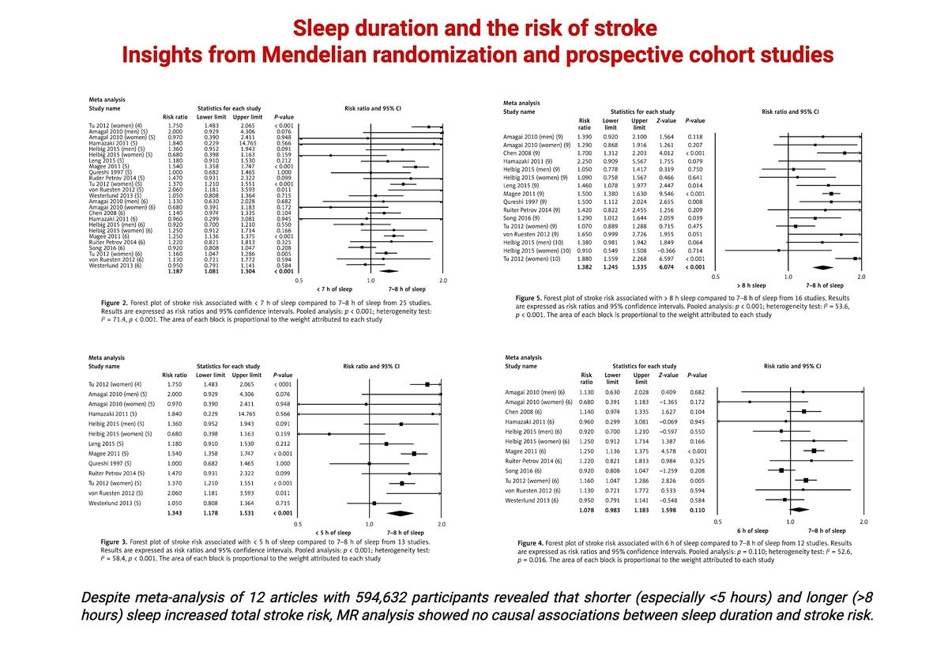

Sleep duration may not have any effect on the risk of stroke: insights from Mendelian randomization and prospective cohort studies
DOI: 10.5114/aoms/144295
Arch Med Sci 2026;22(2):721-734
Notes:
Introduction
Due to contentious associations between sleep and stroke risk, we performed a meta-analysis of cohort studies and Mendelian randomization (MR) analysis.
Material and methods
For the meta-analysis, we pooled prospective studies and reviewed the largest genome-wide association studies investigating self-reported or accelerometer-derived sleep duration in relation to stroke subtype: ischemic (IS), cardioembolic (CES), large artery (LAS), or small vessel (SVS). The inverse-variance weighted method (IVW), weighted median (WM)-based method, MR-Egger and MR-Pleiotropy RESidual Sum and Outlier (PRESSO) were performed. To determine the impact of single nucleotide polymorphisms (SNPs), the leave-one-out method was applied.
Results
Pooled prospective studies demonstrated that both shorter (< 7 h) [n = 25 studies, I2 = 71.4, p < 0.001; risk ratio (RR) = 1.18, 95% CI: 1.08–1.30, p < 0.001] and longer (> 8 h) [n = 16 studies, I2 = 53.6, p < 0.001; RR = 1.38, 95% CI: 1.24–1.53, p < 0.001] sleep increased stroke risk (compared with 7–8 h), but were subject to high levels of heterogeneity. In MR, self-reported sleep duration had no significant effect on IS (IVW: beta = –0.031, p = 0.747), CES (IVW: beta = –0.039, p = 0.849), LAS (IVW: beta = –0.246, p = 0.328) or SVS (IVW: beta = –0.102, p = 0.667) risk. This was also observed for short and long accelerometer-derived sleep (all p > 0.126). Estimated associations had no significant heterogeneity, and MR-PRESSO revealed no outliers. There was low likelihood of pleiotropy (all estimations p > 0.539), and associations were not driven by single SNPs.
Conclusions
Meta-analysis revealed that shorter and longer sleep increased total stroke risk, but with high heterogeneity. MR analysis showed no causal associations between sleep duration and stroke risk.

