Slide 1
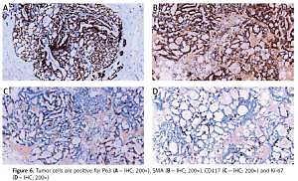

Diagnosis of adenoid cystic carcinoma in the breast: a case report and literature review
DOI: 10.5114/aoms/144321
Arch Med Sci 2022;18(1):279-283

