Slide 1
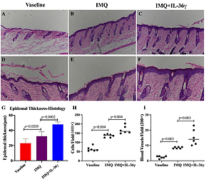

IL-36γ promotes psoriasis-like features in keratinocytes in an imiquimod-induced murine model of psoriasis
DOI: 10.5114/aoms/145396
Notes:
Introduction
Psoriasis is a recurrent, chronic inflammatory skin disease with complex pathogenesis. The disease imposes a heavy burden on patients. Interleukin (IL)-36γ belongs to the IL-36 family and is predominantly expressed by epithelial cells. IL-36γ is upregulated in psoriasis lesions. However, the effects of IL-36γ in keratinocytes remain unclear.
Material and methods
Eighteen IL-36γ-deficient mice were divided into three groups: the vaseline group, the imiquimod (IMQ) group, and the IMQ/IL-36γ group. Vaseline or IMQ was administered for 6 consecutive days. The severity of psoriasis-like lesions was evaluated using a modified Psoriasis Area and Severity Index (PASI) scoring system. Production of cytokines and expression of differentiation markers were assessed by immunohistochemistry.
Results
IMQ-induced psoriasis lesions were significantly more severe in IMQ/IL-36γ-treated mice compared with vaseline-treated and IMQ-treated mice, as shown by an exacerbated inflammatory phenotype, increased numbers of blood vessels, increased infiltration of cells, and increased epidermal thickness. Expression of loricrin and keratin 5 in skin lesions was decreased following treatment with IL-36γ. Levels of IL-17A, interferon-γ, β-catenin and Dickkopf-related protein 1 were elevated in keratinocytes within psoriatic lesions following IL-36γ stimulation.
Conclusions
Together, these data showed that IL-36γ contribute to abnormal keratinocytes proliferation and keratinocyte-related proinflammatory cytokines, and suggest that IL-36γ may play an important role in the pathogenesis of psoriasis.

