Slide 1
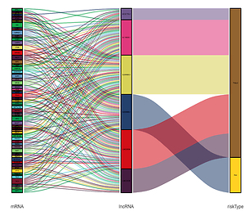

Development and validation of a prognostic nomogram for lower-grade glioma based on an autophagy-related lncRNA signature
DOI: 10.5114/aoms/145435
Notes:
Introduction
Gliomas account for 75% of the primary malignant brain tumors. The prognosis and treatment planning vary in lower-grade gliomas (LGG) due to their heterogeneous clinical behaviors. The dysregulation of autophagy-related (ATG) lncRNAs plays a crucial role in LGG. We aimed to develop and validate an ATG lncRNA risk signature, and a survival nomogram with integration of novel prognostic for LGG patients.
Material and methods
Differentially expressed ATG lncRNAs were screened out based on TCGA and GTEx RNA-seq databases. ATG lncRNA prognostic signature was then established by Kaplan–Meier, univariate Cox proportional hazards regression, Least absolute shrinkage and selection operator (LASSO) regression and multivariate Cox proportional hazards regression, with its predictive value validated by time-dependent receiver operating characteristic (ROC) curves. Kaplan–Meier, univariate Cox regression and multivariate Cox proportional hazards regression were used to screen out clinical and molecular variables. A nomogram was developed and internally validated by ROC and calibration plots.
Results
An ATG lncRNA risk signature was constructed with six differentially expressed lncRNAs (LINC00599, LINC02609, AC021739.2, AL118505.1, AL354892.2, and AL590666.2). Based on the risk signature, a nomogram was developed by addition of the significant prognostic clinical variables (age and grade) and molecular variables (IDH status and MGMT status).
Conclusions
We identified an ATG lncRNA risk signature and develop a nomogram for individualized survival prediction in LGG patients. A user-friendly free online calculator to facilitate the use of this nomogram among clinicians is also provided: https://linstu2009.shinyapps.io/LGGPRODICTORapp/?_ga=2.3154800.1506830296.1588641469-159983587.1588641469.

