Slide 1
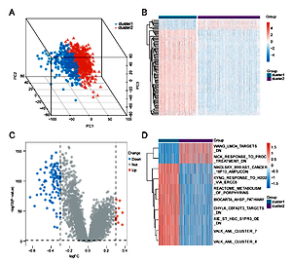

The role of the ferroptosis-related gene in the immune activity and prognosis of sepsis
DOI: 10.5114/aoms/145473
Notes:
Introduction
Sepsis is a leading cause of mortality in intensive care units worldwide. Ferroptosis, a form of regulated cell death dependent on iron, has been proven to be altered during sepsis, including increased iron transport and uptake into cells and decreased iron export. A better understanding of the role of ferroptosis in sepsis should expedite the identification of biomarkers for prognostic evaluation and therapeutic interventions.
Material and methods
We used the mRNA expression profiles of sepsis patients from Gene Expression Omnibus (GEO) to analyze the expression level of ferroptosis-related genes and construct molecular subtypes.
Results
Two distinct ferroptosis patterns were determined, and the overall survival of the two clusters was highly significantly different. Gene comparison analysis was performed on these two groups, and there were a total of 106 differentially expressed genes (DEGs). Pathway enrichment analysis of these genes showed that ferroptosis and immune-related pathways were enriched, suggesting that immune pathways might be critically involved in sepsis. To systematically predict the prognosis of sepsis, we constructed a nomogram model; the calibration plot nomogram showed excellent concordance for the 7-, 14-, and 28-day predicted and actual overall survival probabilities. Finally, the results of bioinformatics analysis were validated in animal and cell models.
Conclusions
In this study, we construct a ferroptosis-related nomogram that can be used for prognostic prediction in sepsis. In addition, we revealed that ferroptosis played a non-negligible role in immune cell infiltration and guiding more effective immunotherapy strategies.

