Slide 1
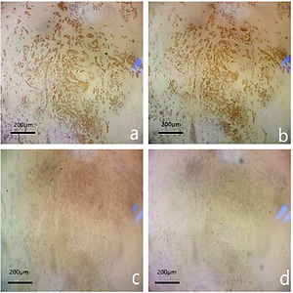

Diagnostic performance of superb microvascular imaging combined with shear-wave elastography in distinguishing invasive ductal carcinoma molecular subtypes
DOI: 10.5114/aoms/145596
Notes:
Introduction
The aim of the study was to explore the diagnostic value of combining superb microvascular imaging (SMI), shear-wave elastography (SWE), and the Breast Imaging Reporting and Data System (BI-RADS) to distinguish different molecular subtypes of invasive ductal carcinoma (IDC).
Material and methods
A total of 239 surgically confirmed IDC masses in 201 patients underwent conventional ultrasound, SMI, and SWE examination; information such as echo pattern, posterior features, margins, SMI pixels, and hardness of the masses was recorded. According to the St. Gallen standard, breast masses were classified as Luminal A, Luminal B, HER2 overexpression, and triple-negative subtype. We further explored the differences between different molecular subtypes of IDC.
Results
Luminal A subtype had the following characteristics: low histologic grade, posterior acoustic shadowing (<i>p</i> = 0.019), spiculated margins (<i>p</i> < 0.001), and relatively soft. Luminal B subtype was characterized by low histological grade (<i>p</i> < 0.0001), posterior acoustic shadowing or indifference, and indistinct margins. HER2 overexpression breast cancers were characterized by high histological grade, enhanced posterior acoustics or indifference, calcifications (<i>p</i> = 0.005), spiculated or indistinct margins, vascularity (<i>p</i> = 0.005), and relative stiffness. Triple-negative breast cancers had the characteristics of high histological grade, posterior echogenic enhancement, lack of calcifications, circumscribed or microlobulated margins, low blood flow signals, and stiff tissue (<i>p</i> = 0.013).
Conclusions
Our study demonstrated the significant differences and trends among the four IDC subtypes by the combined application of SMI, SWE, and BI-RADS lexicon, which are of great significance for early diagnosis, selection of treatment methods, and evaluation of prognosis of IDC.

